Slide 1
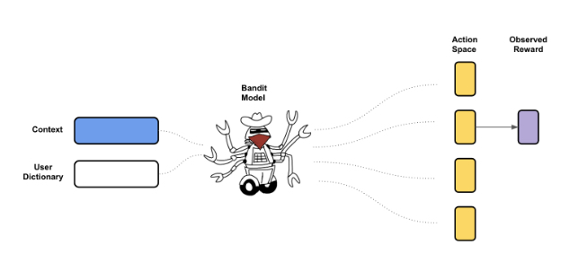
Deep and Wide Bandit

Slide 2
Exploration vs. Exploitation
Exploration - randomly choose an action
Get better statistics on rewards
Too much exploration results in waste of resources on suboptimal actions
Exploitation - choose the best action based on current model
Good chance of getting good rewards
May get stuck on suboptimal actions
Bandit algorithms - balance between exploration and exploitation

Slide 3
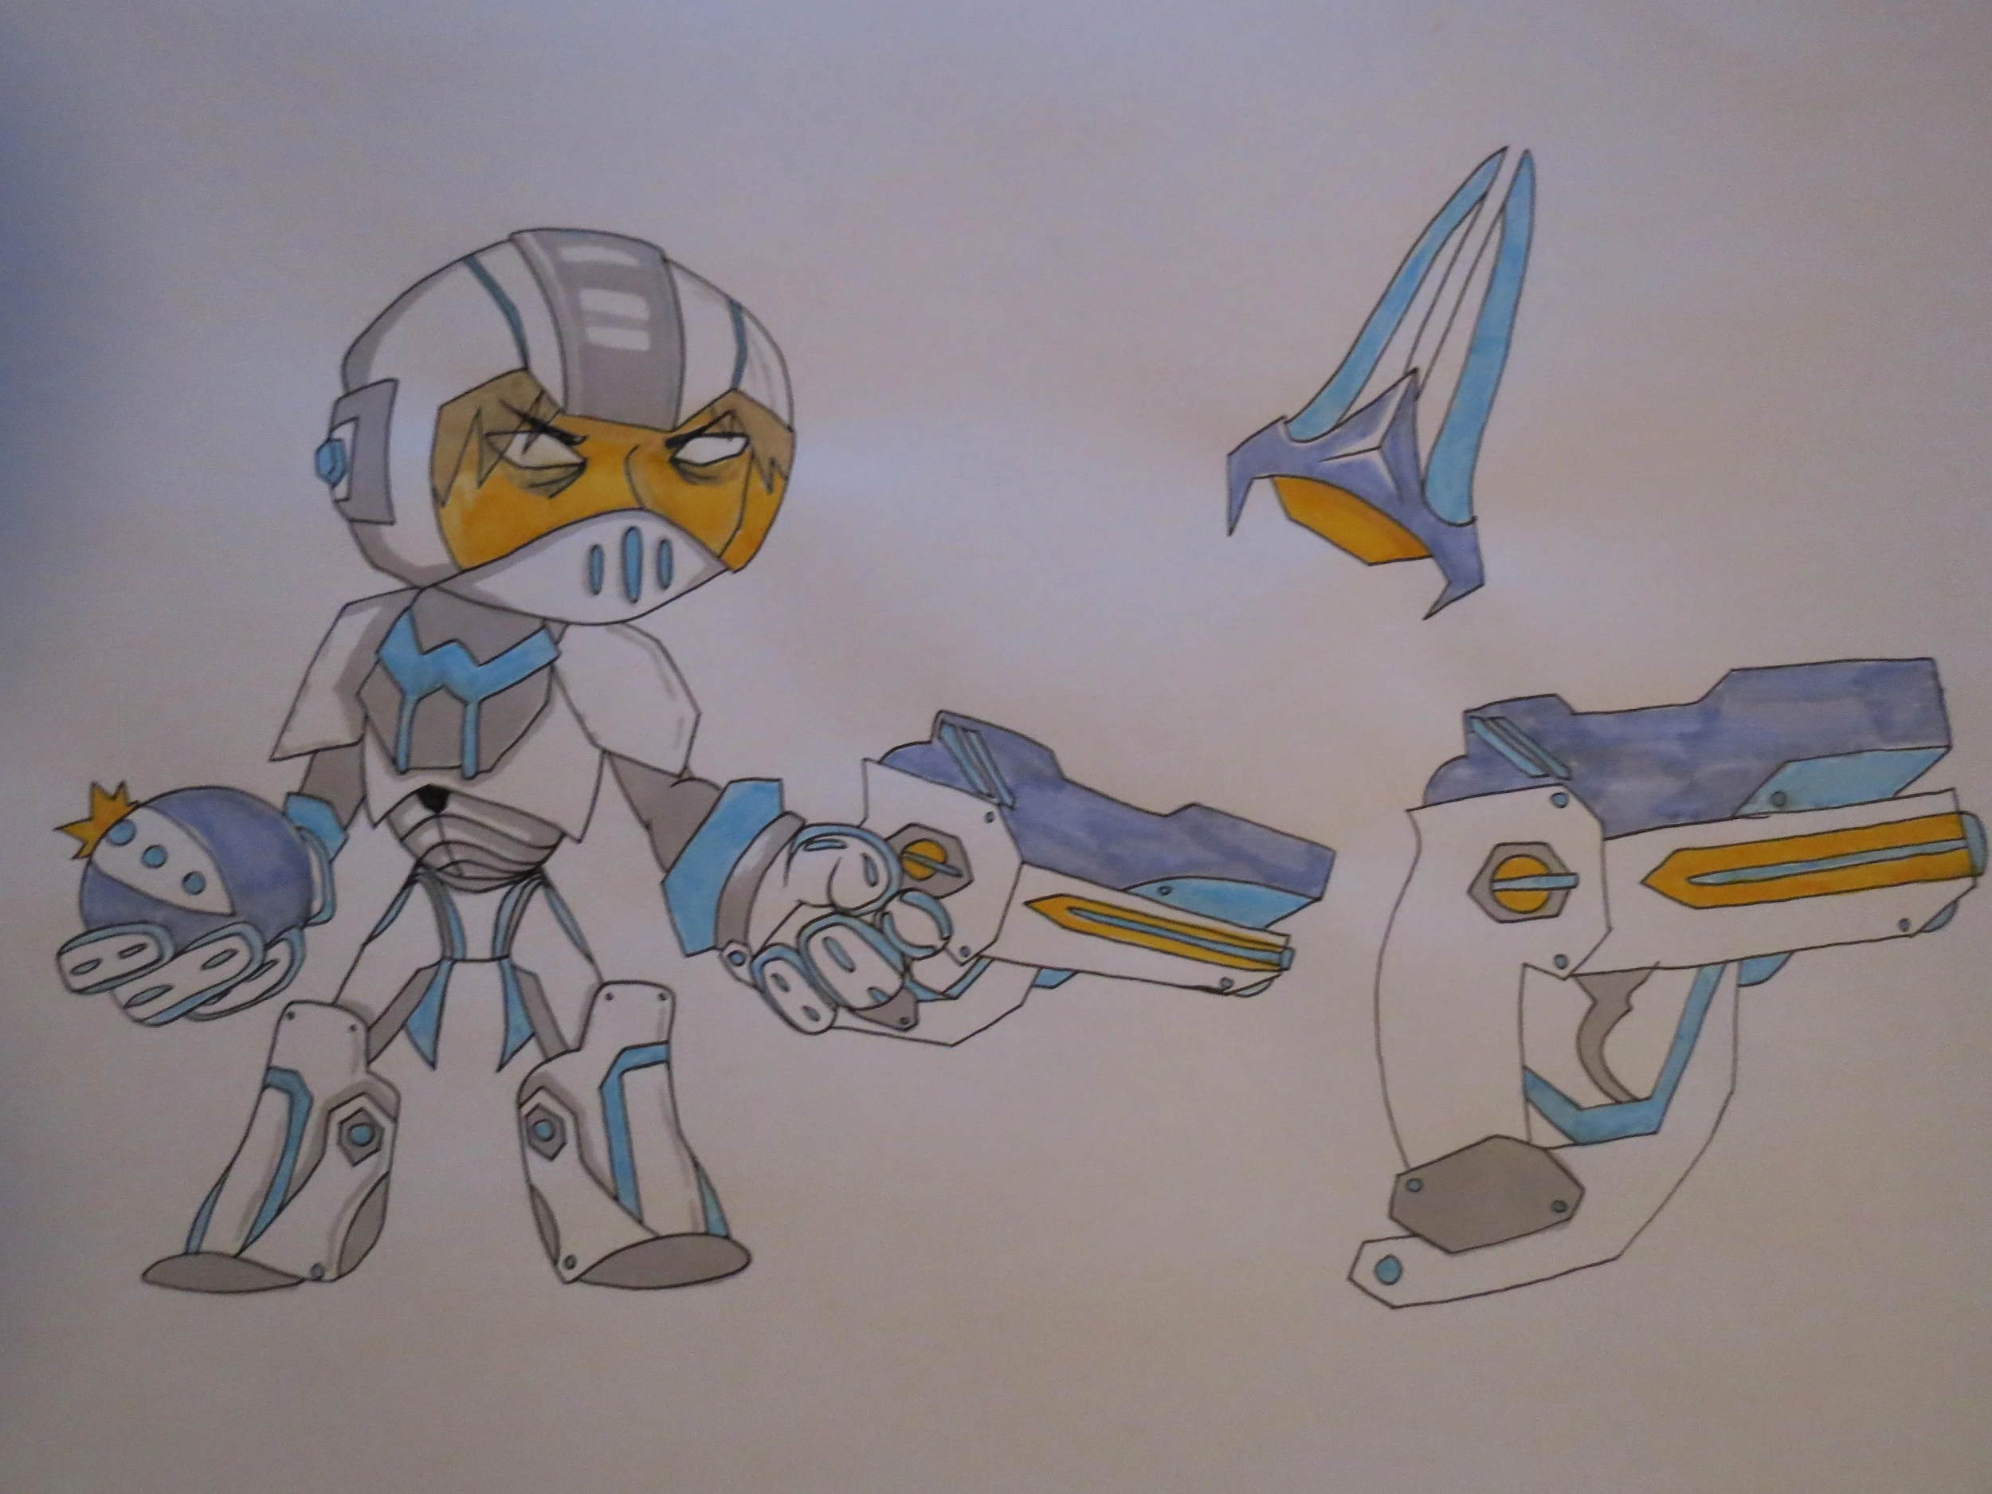
Space Bandits
Deep neural network + Bayesian linear regression
Use Bayesian statistics to sample and update reward distributions

Slide 4
Context (e.g. user age, location, email campaign type...etc.)
User ID
Model
Choose best action or explore
Promotion 1
Action Space
Promotion 2
Promotion 3
Reward

Slide 5
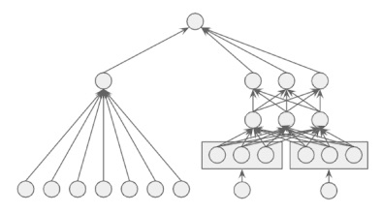
Deep and Wide model
Space bandits can only take context as input, does not consider individual users
Memorize individual users
Generalize using contexts

Slide 6
What we did this week
Learn about the multi-armed bandit problem and its solutions
Exploratory data analysis
Define reward function
Created a simple deep and wide model
Tested it on a toy problem
Working on testing it on our dataset

